Slide 1
High Performance Computing Based on a Smart Grid Approach
1
Name: Shammo Faiyaz Ahmed
ID: 23241032
Group: 2
CSE 449, Task 2
ST: Farah Binta Haque
RA: Md Sabbir Hossain

Slide 2
2
Table of contents
01
Introduction
02
Previous Works
03
Proposed Methodology
04
Result Analysis
05
Conclusion and Future Work

Slide 3
3
Introduction
Virtualization Techniques (Cloud)
Reduced computation and storage costs
Sharing the resources (GPU) will reduce the energy consumption costs
Smart grid architecture
Provides an easy access to HPC computational resources
Done by linking powerful computational resources own by domestic user into a smart HPC service with for profit objectives

Slide 4
4
Previous Works
SETI@home project, utilized large-scale distributed computing to search for radio signals from extraterrestrial civilizations
BOINC project, which uses hosts
Crowdware project, which utilizes auction based price model and considers energy consumption from GPU specifications
Frameworks like OpenCL and CUDA

Slide 5
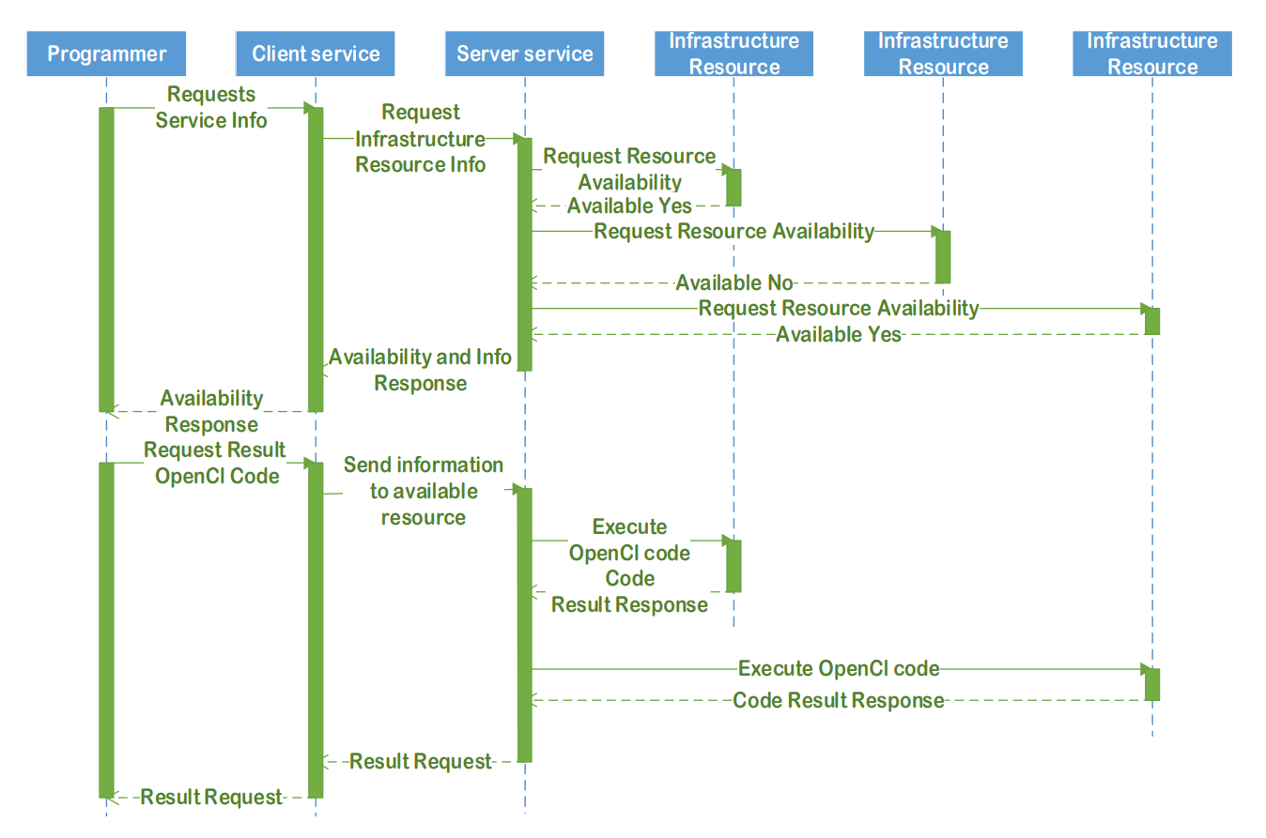
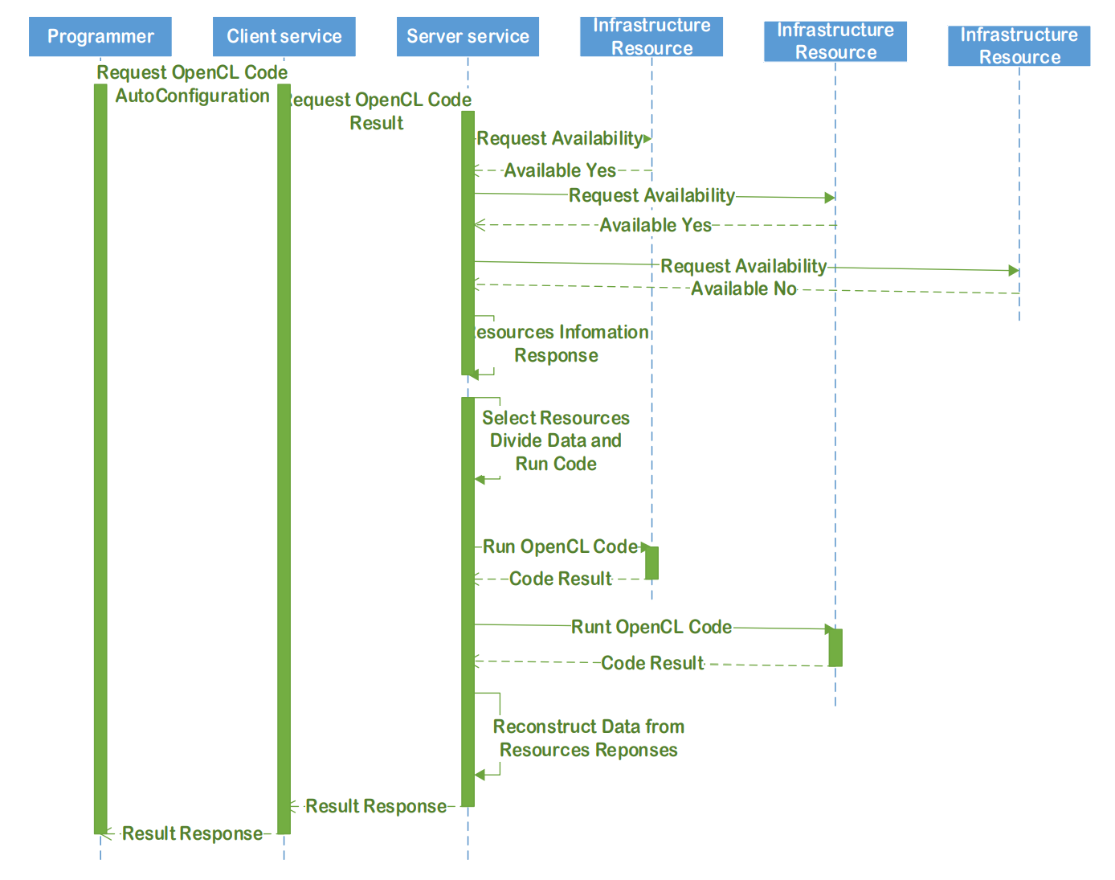
5
Proposed Methodology
Eliminate the reliance on data centers, clusters, or cloud services
TCP/IP infrastructure
Server Engine Application (SEA)
Client Engine Application (CEA)
GPU Virtualization
Algorithm decides between using CPUs/GPUs
Manual Selection
Auto Selection

Slide 6
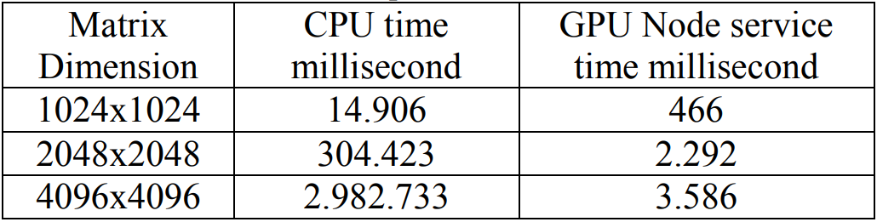
6
Result Analysis
The proof of concept (POC) comprises three applications: client service, node service, and OpenCL service
A significant decrease in cost and energy consumption
Resource sharing made easy!
Sending information across the internet to a powerful node and waiting for the result is quicker than local execution
Effectiveness was measured through the execution times for matrix multiplication on local machines and powerful nodes

Slide 7
7
Conclusion & Future Work
Potential of creating a High-Performance Computing (HPC) infrastructure similar to volunteer computing
New framework from scratch with a proof-of-concept goal
Evaluation on energy consumption has been made!
In the future, this model can be used to assess the performance of smart grids and create an Application Programming Interface (API) for easy utilization of the grid
Thank you!

